Slide 1

HOW CERTAIN FACTORS AFFECT CHRONIC DISEASE INDICATORS
KARMISHTHA SETH

Slide 2
INDEX
Introduction
Aim
Methods
Results
Conclusion

Slide 3
CHRONIC DISEASES
“Conditions that last 1 year or more and require ongoing medical attention and/or limit daily activities.”
Examples : Heart Disease, Cancer, Diabetes.
Common Causes : Tobacco Use (directly or indirectly), Poor Nutrition, Lack of Physical Activity, Excessive Alcohol Use, etc…

Slide 4
AIM
“The intent of my project is to examine how various factors such as geolocation, age, gender, race, ethnicity, affect chronic disease indicators, and see if there are any interesting trends in certain groups.”

Slide 5
METHODS
Data Collection:
Selection of Variables
Predictor Variables – Location and Stratification
Dependent Variable – Topic (type of CD)
Variable Distribution
Decision Tree:
Provides a framework to quantify the values of various outcomes and the probabilities of achieving them
Shows what CD one would be likely to have based on Location and Stratification
Random Forest
Use it to predict likelihood of CD

Slide 6
n = 403985, variables = 34

Slide 8
RESULTS

Slide 9
DISTRIBUTION OF VARIOUS FACTORS

Slide 15
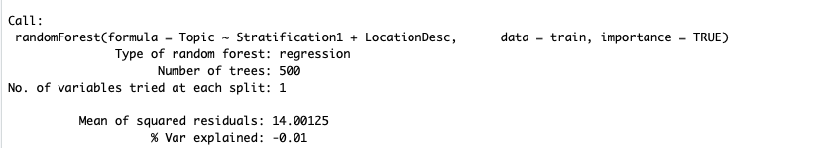
RANDOM FOREST ALGORITHM

Slide 16
CONCLUSION
There is a significant interaction of type of chronic diseases and the location and stratification of subject. Using the decision tree, I am able to predict which disease a subject is more likely to be susceptible to based on the predictor variables.
I can implement this decision tree into real world cases also. For example, I can analyze how likely a person would be to have COVID-19 based on their ethnicity, age and location.

